Slide 1
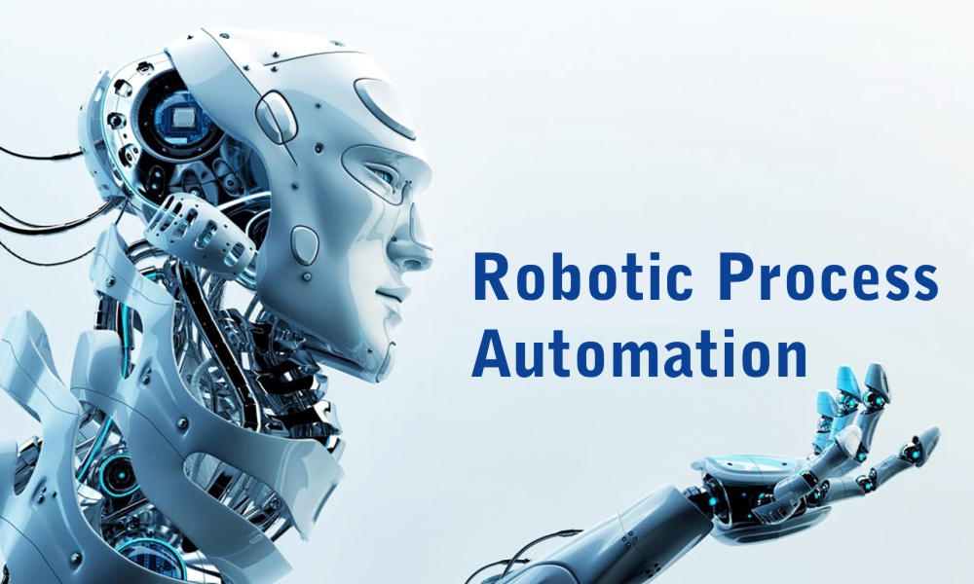

Slide 2
Index
What is RPA
Some more about RPA
How does RPA Works?
RPA Tools
RPA Common Capabilities
RPA Benefit
Applications of RPA
Advantages of RPA
Disadvantages of RPA
Summary

Slide 3
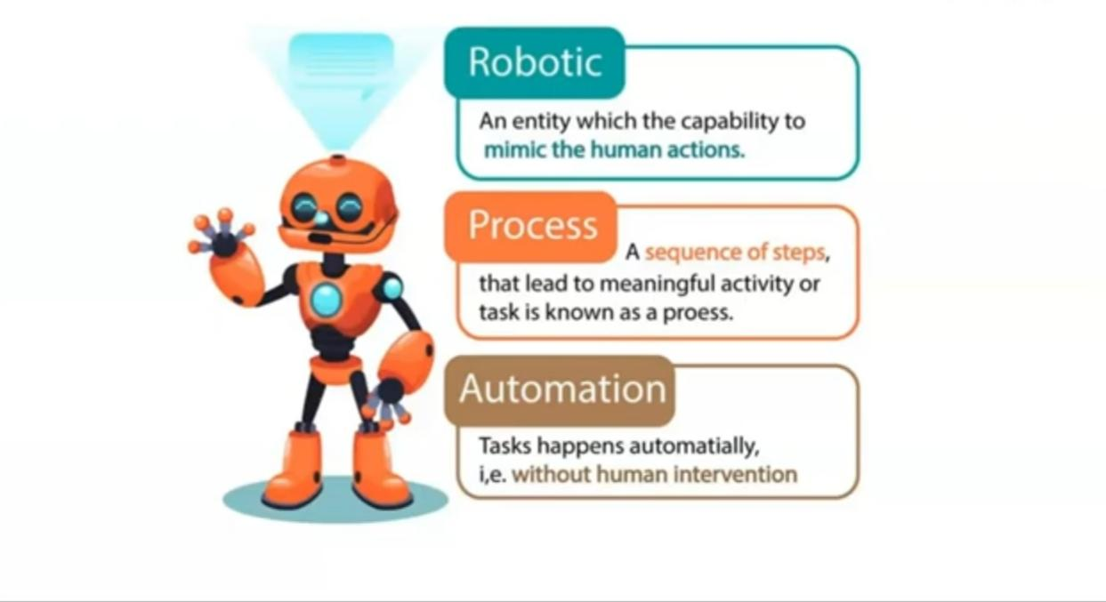

Slide 4

What is RPA
The process of automating business operations with the help of robots to reduce human intervention is said to be Robotic Process Automation (RPA).

Slide 5
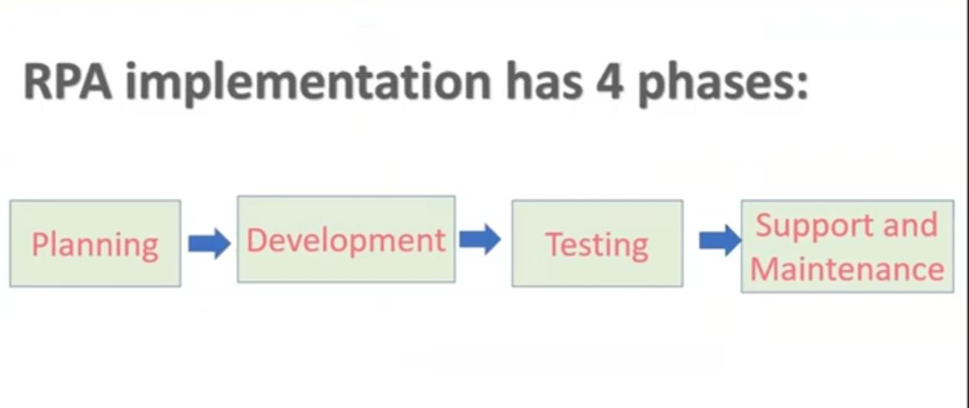
Some more about RPA

Slide 6
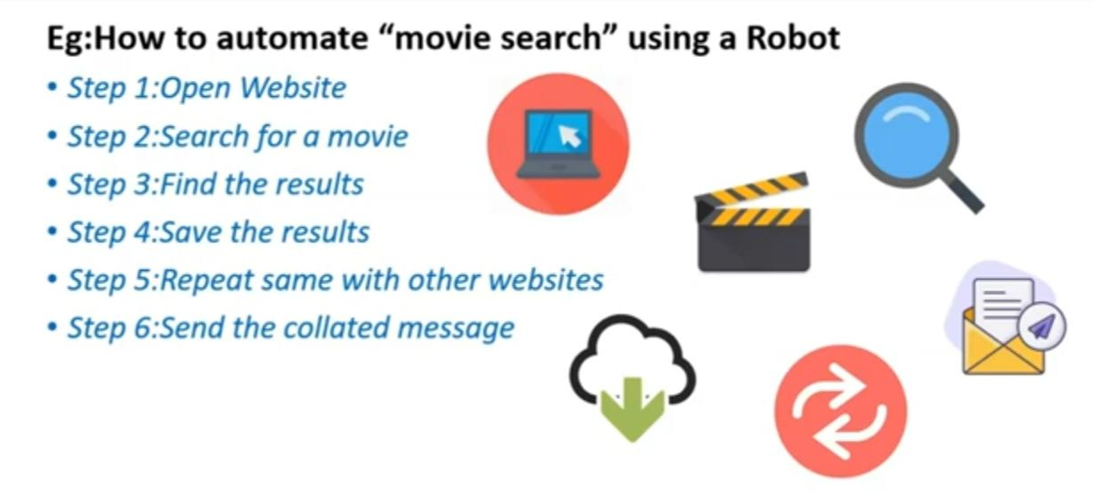
How does RPA Works?

Slide 7

RPA Tools

Slide 8
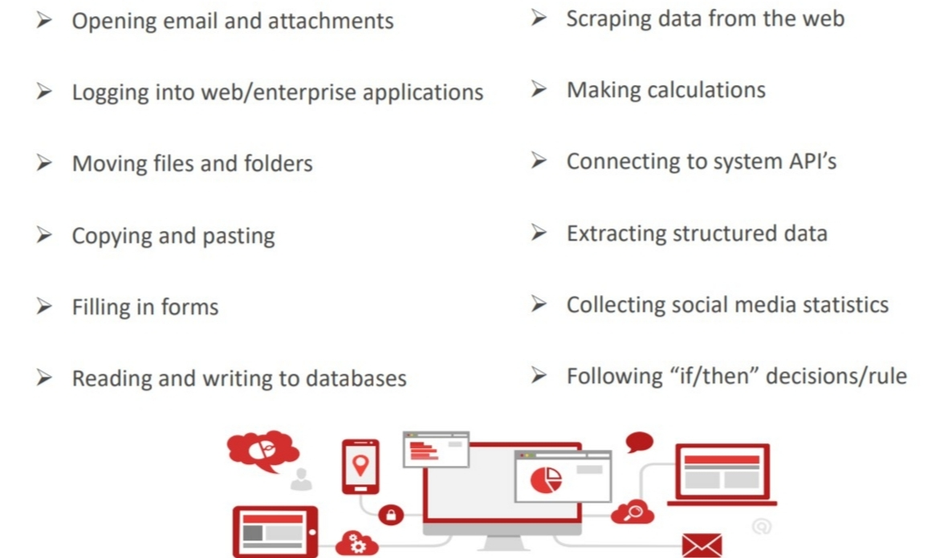
RPA Common Capabilities

Slide 9
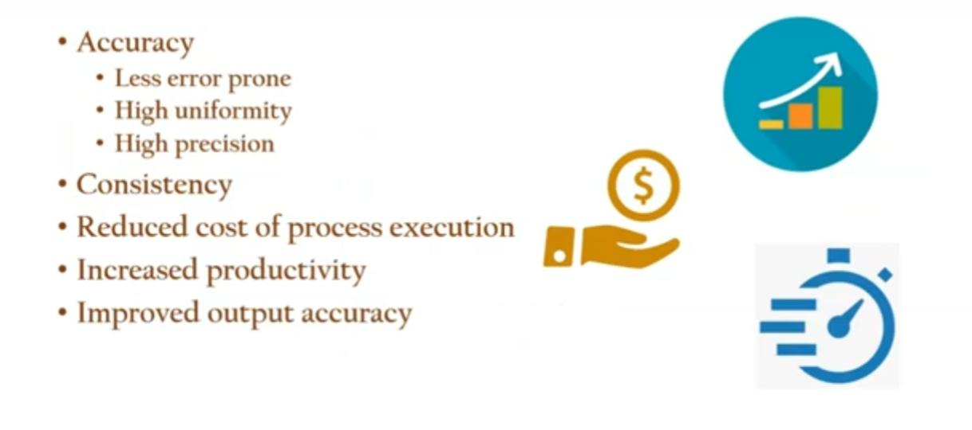
RPA Benefits

Slide 10
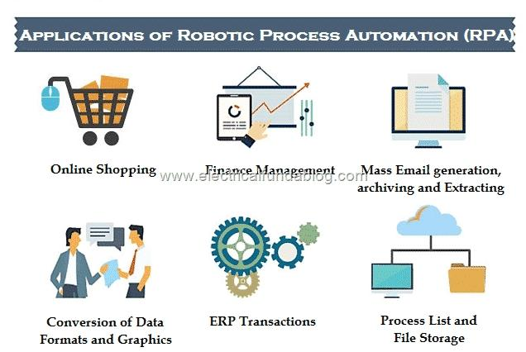

Slide 11
Advantages of RPA
Increased Productivity. Most RPA robots are designed to focus on performing specific routine tasks.
Increased Efficiency.
Enhanced Accuracy.
Increased Security.
Boost in Scalability Opportunities.
Improved Analytics.
Enhanced Customer Service.
Non-disruptive.

Slide 12
Disadvantages of RPA
The automated task increases unemployment. ...
The complexity of implementation in RPA has decreased day-by-day. ...
There is no innovative thinking in Robotic Process Automation.
The RPA project or system needs regular reconfiguration.
It is a costly technology as compare to any other technology.

Slide 13
Summary
• Robotic Process Automation allows organizations to automate task just like a human being was doing them across application and systems.
• The main goal of Robotics process automation is to replace repetitive and boring clerical task performed by humans, with a virtual workforce.
•RPA is used in wide range of industries like Healthcare, Insurance, Banking, IT etc

Slide 14
THANK YOU
Presented by : vidya k s
Roll no : 55
S5 ct

